Slide 1




Team 6
YouTube Trending
Video
Analysis
Team 6A
Maraline Torres, Ying Zhang, Yujia Cao,
Yuting Gong, (Bruce)Chang-Hung Hou

Slide 2



TEAM 6
INTRODUCTION
As YouTube viewers become more and more diverse, video watching preference varies more significantly between different groups of categories than ever.
OUR GOAL:
Exploratory analysis of characteristics, including categories, view, likes count and trending time in trending videos identify changes in preference.
We are interested to know if the country culture has an influence on the YouTube trending videos characteristics.
Data source:
This data source were collected using the YouTube API and it presents a list of the top trending videos on the platform. To determine the year‘s top-trending videos, YouTube uses a combination of factors such as number of views, shares, comments and likes. We accessed the data source via Kaggle data notebooks "Trending YoTube Video Statistics" and "YouTube Trending Video Dataset".

Slide 3

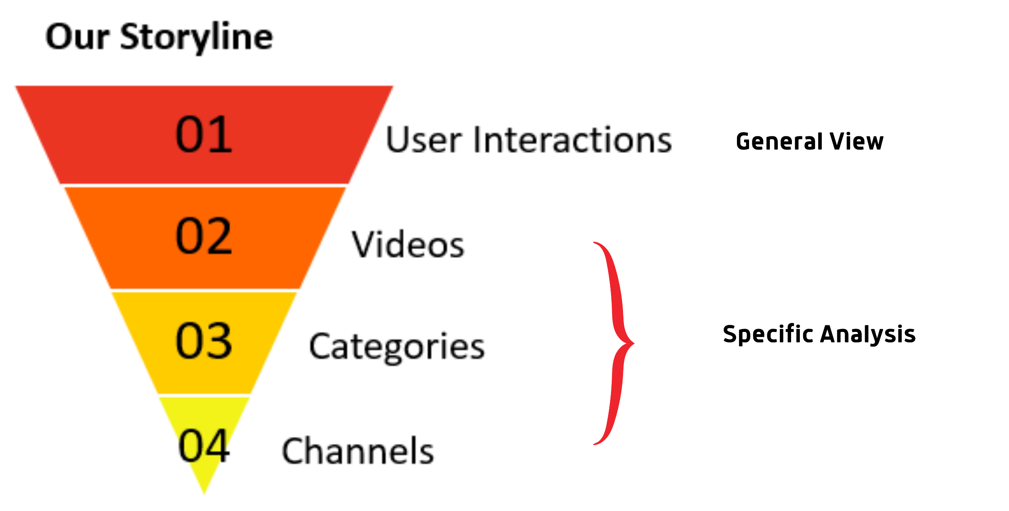
Getting to know our dataset
Team 6
Team 6
Dataset: 71,868 entries, 16 columns. Data were collected in the year of 2018 and 2020.
On average, we have data on about 318 trending videos per day for a total of 226 days
According to our dataset, for U.S videos, there were 195.58 videos trending on YouTube each day on average. For Japan videos, the number is 150.0

Slide 4





Team 6
YouTube
User
Interactions
views
Likes
Comments
Dislikes

Slide 5

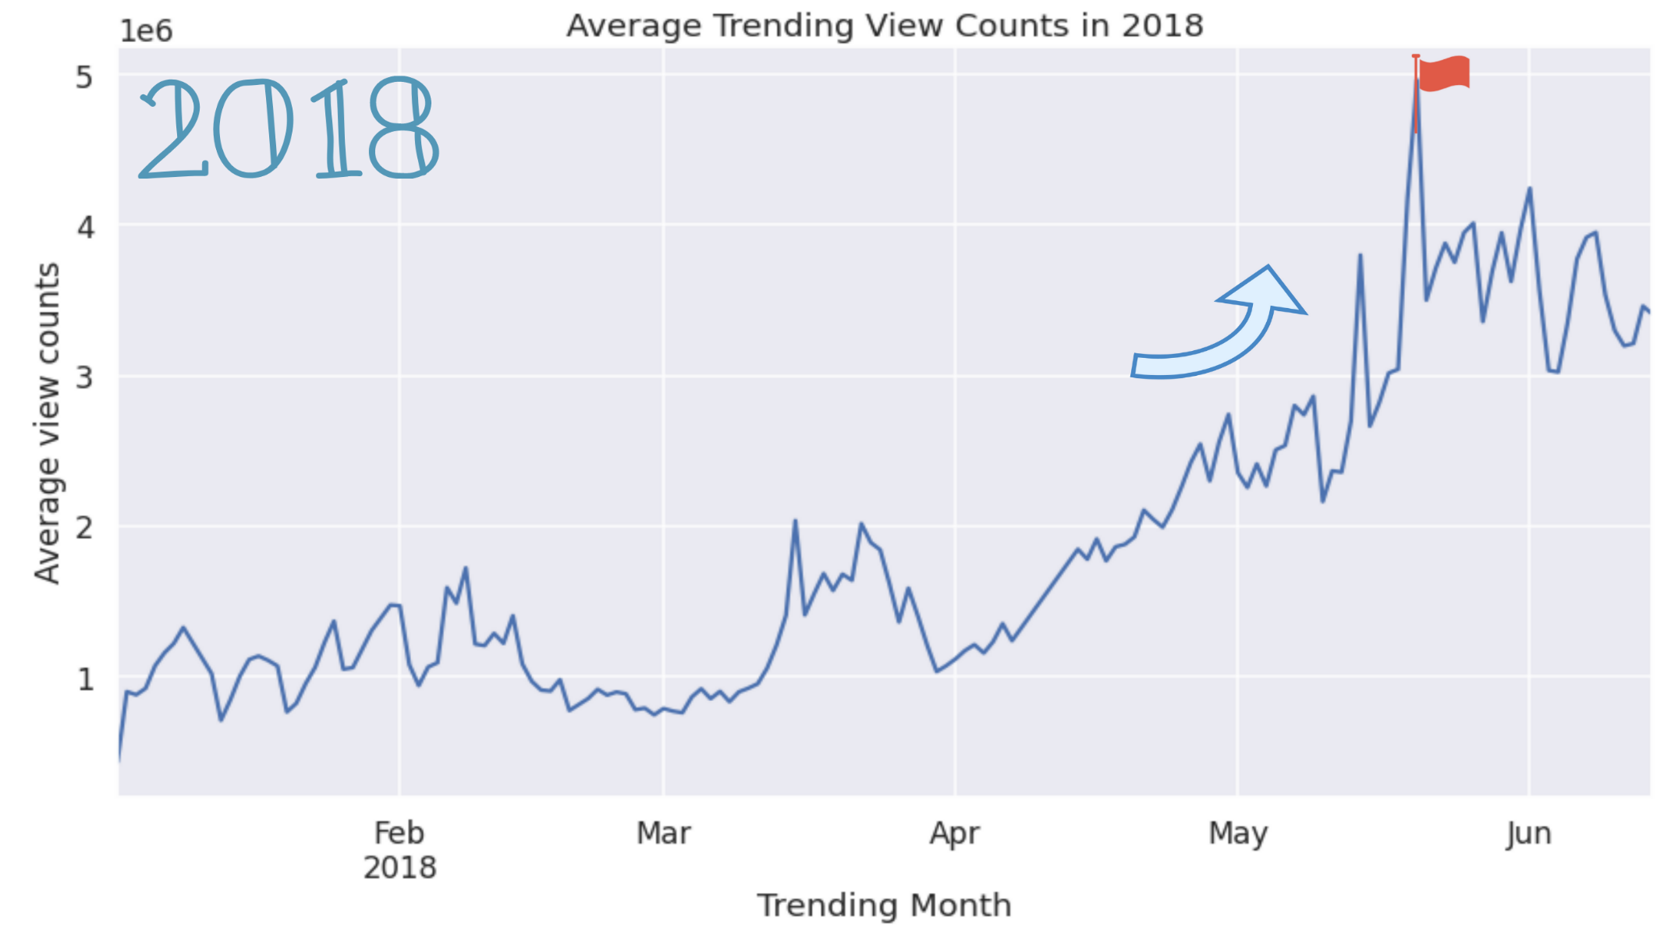
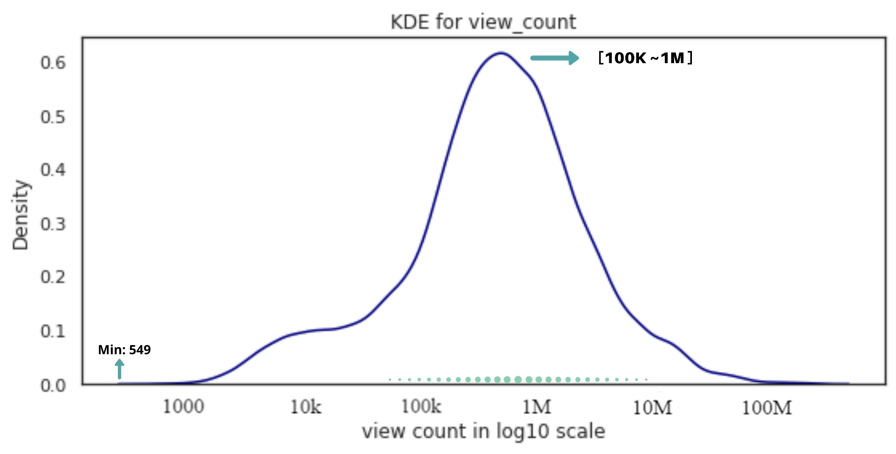
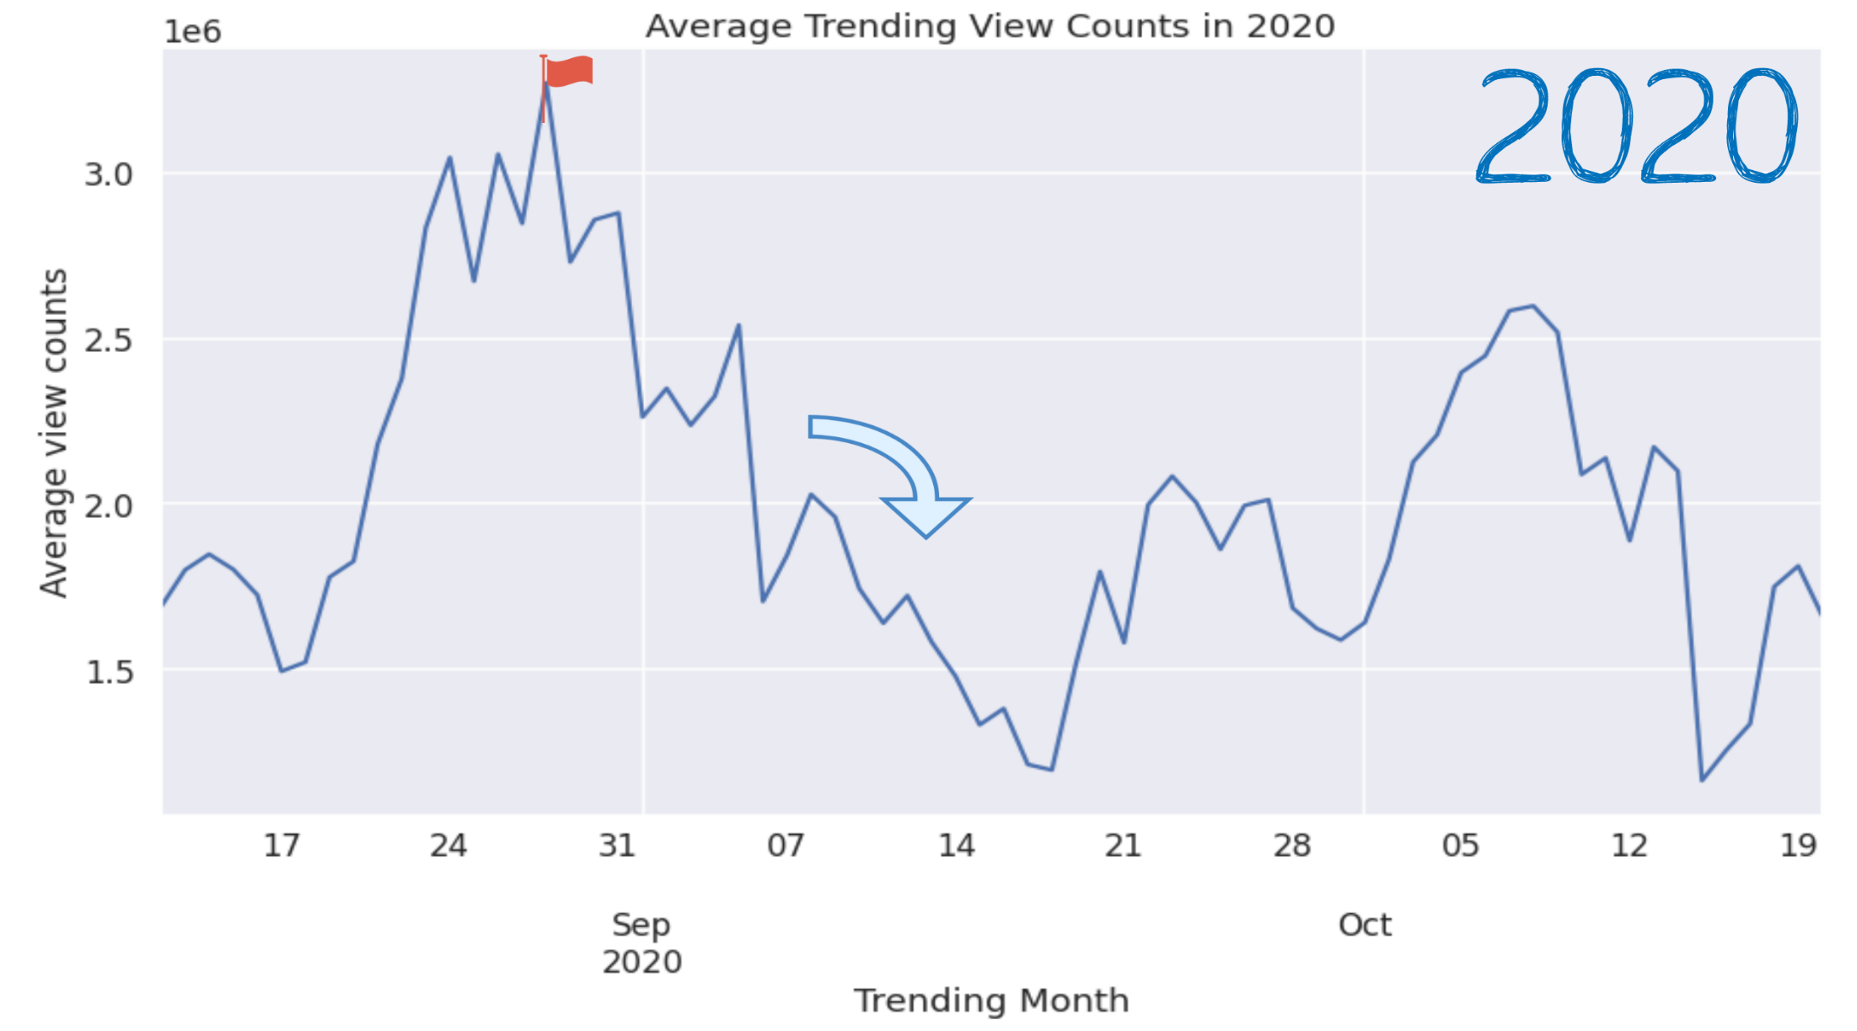
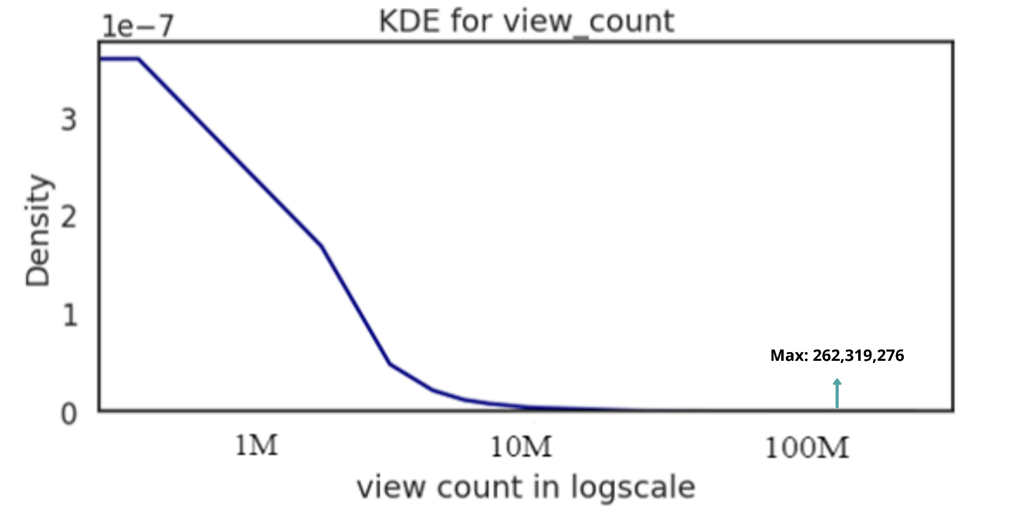

YouTube Trending videos
View counts analysis

Slide 6
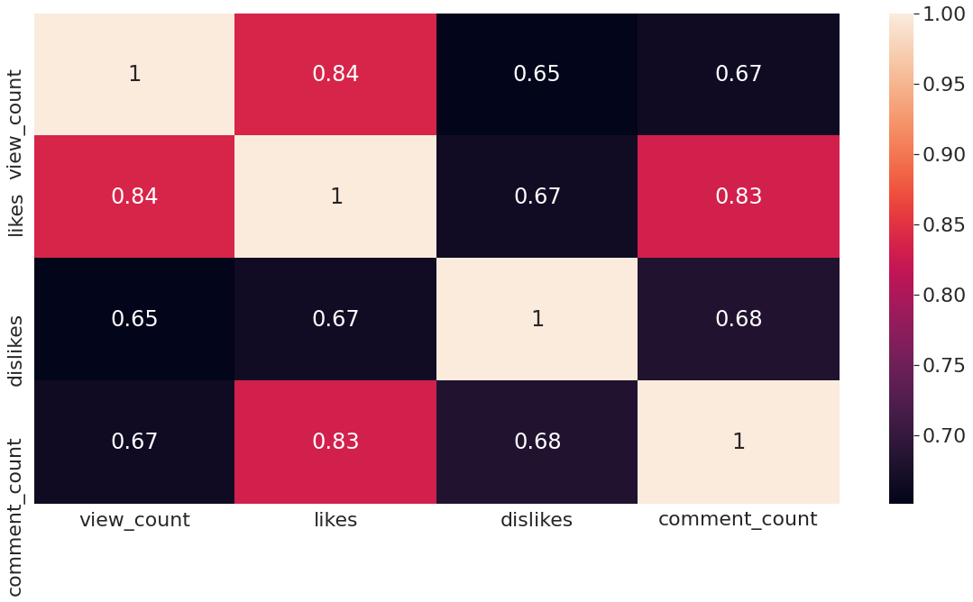
Relationships among User Interaction Features
views
Heatmap
Likes and View Counts show very strong positive correlation.
Comment counts and Likes show very strong positive correlation.
Likes
Comments
Dislikes

Slide 7
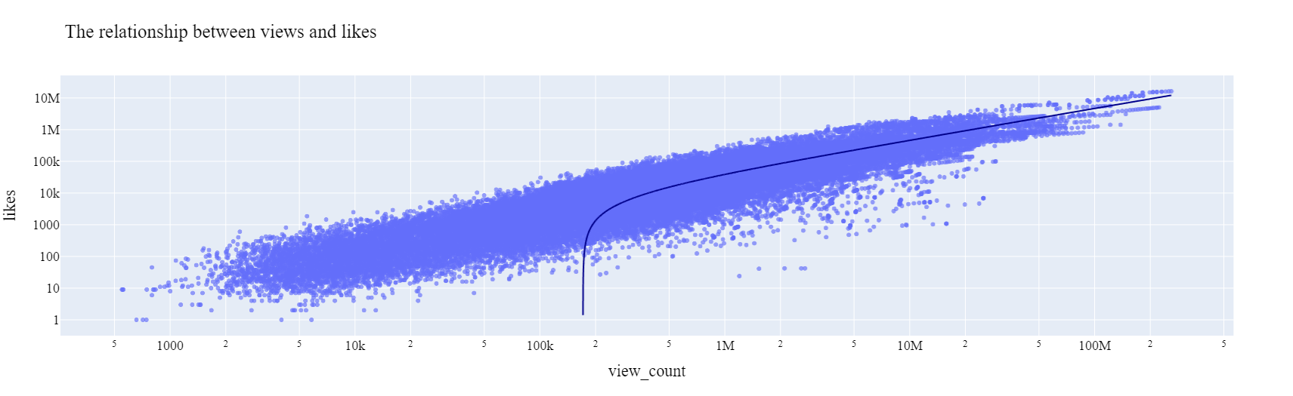
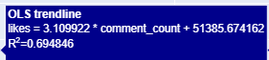
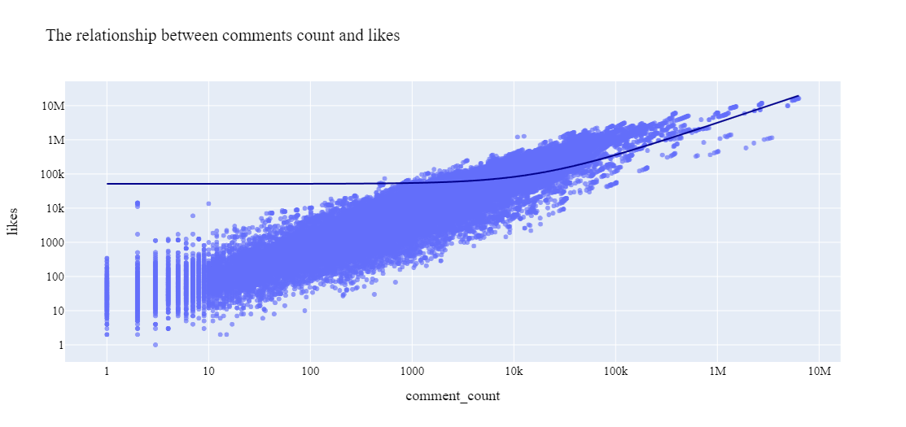
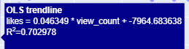
Relationships among User Interaction Features
views
Likes
Comments
Dislikes

Slide 8
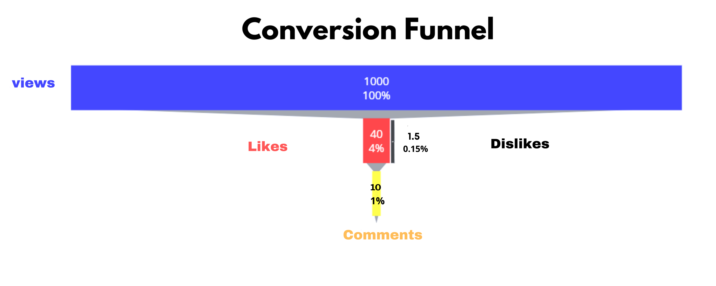
User Interaction features- conversion ratios
On average, YouTubers should expect a 4% like to view ratio, and 1% comment to view ratio.

Slide 9
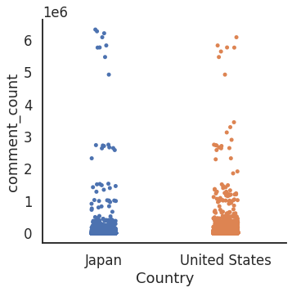

User Interactions in Japan and U.S
RK
Behavior Similarities
Behavior Differences
U.S users tend to have higher view counts and likes counts than Japanese users
U.S videos tend to receive more dislikes compared to Japan videos
The distributions for comment counts are quite similar for Japan and U.S
vs
Comments
Mean of comments count:
6 k
Mean of comments count:
10 k
(increase by 60%)

Slide 10
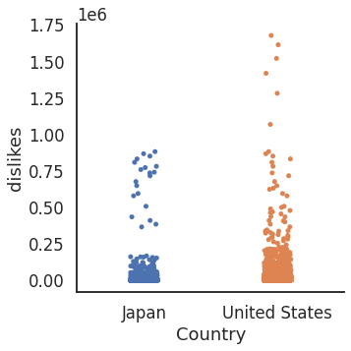
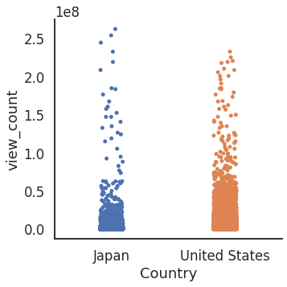
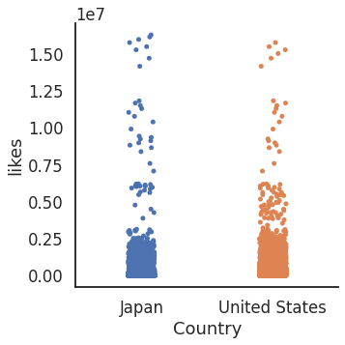



User Interactions in Japan and U.S
RK
U.S users tend to have higher view counts than Japanese users.
U.S users tend to clicks more dislikes than the Japanese users.
Dislikes
Likes
View Count
Mean of dislikes count:
1 K
Mean of dislikes count:
4 K (4 times)
Mean of views count:
800K
Mean of views count:
2 M (1.5 times)
Mean of likes count:
4 k
Mean of likes count:
10k (1.5 times)

Slide 11
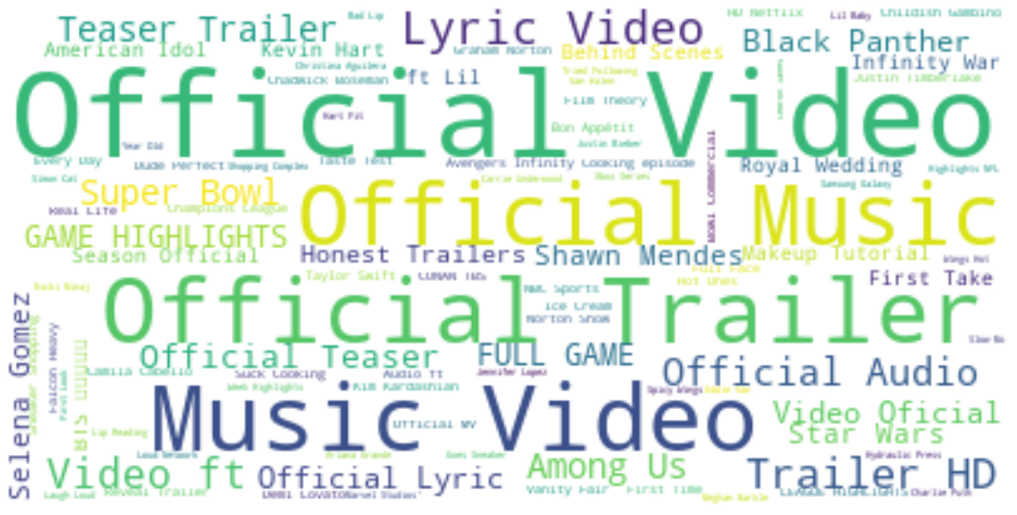
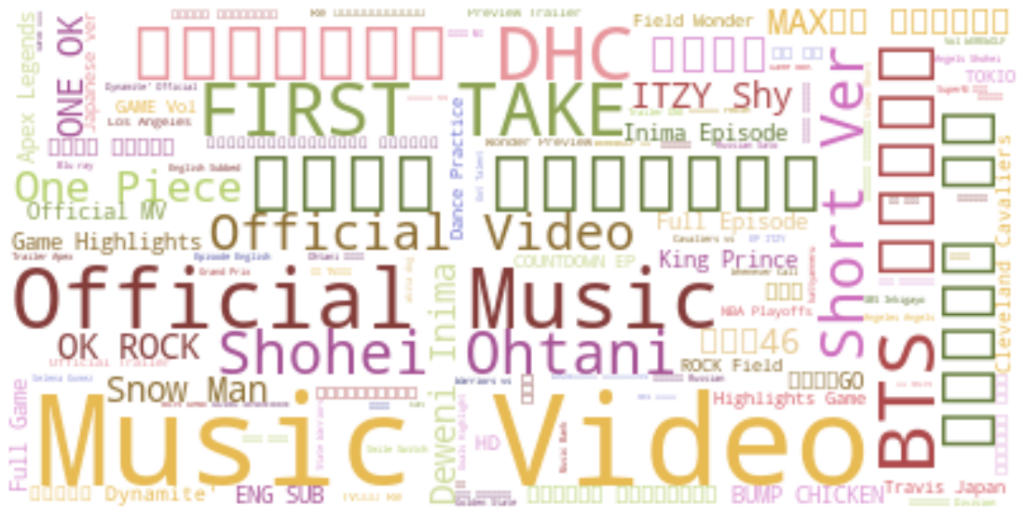
Most common words in Titles
U.S Videos Titles
Japan Videos Titles
Most common words : Official, music videos, trailer, Game Highlight
Cultural Hot words: Black Panther, Infinity War, Super Bowl,
American Idol, Selena Gomez, Among Us
Most common English words : Official, Game highlights
Cultural Hot words:
One Piece( manga series), King&Prince (Japanese idol),
Shohei Ohtani (baseball pitcher), BTS, ITZY,(KPOP)

Slide 12
YouTube Videos Analysis
Top 10 videos for the US/Japan （Analysis for view count/like/dislike)
Days to go trending for videos in 2018/2020 for the US and Japan

Slide 13
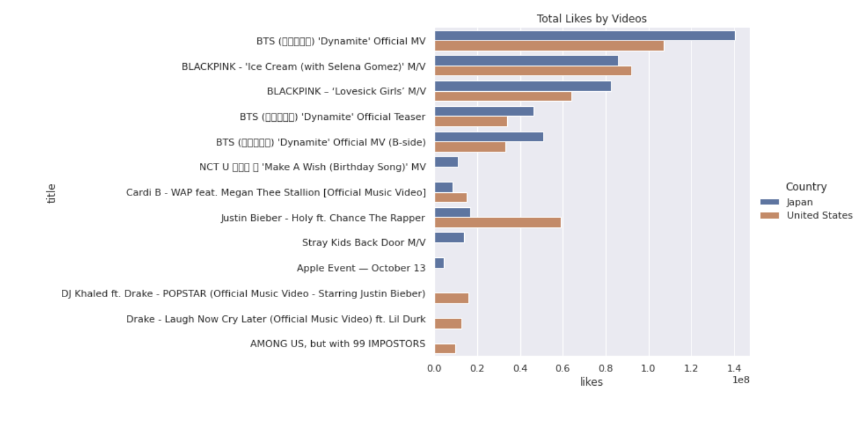
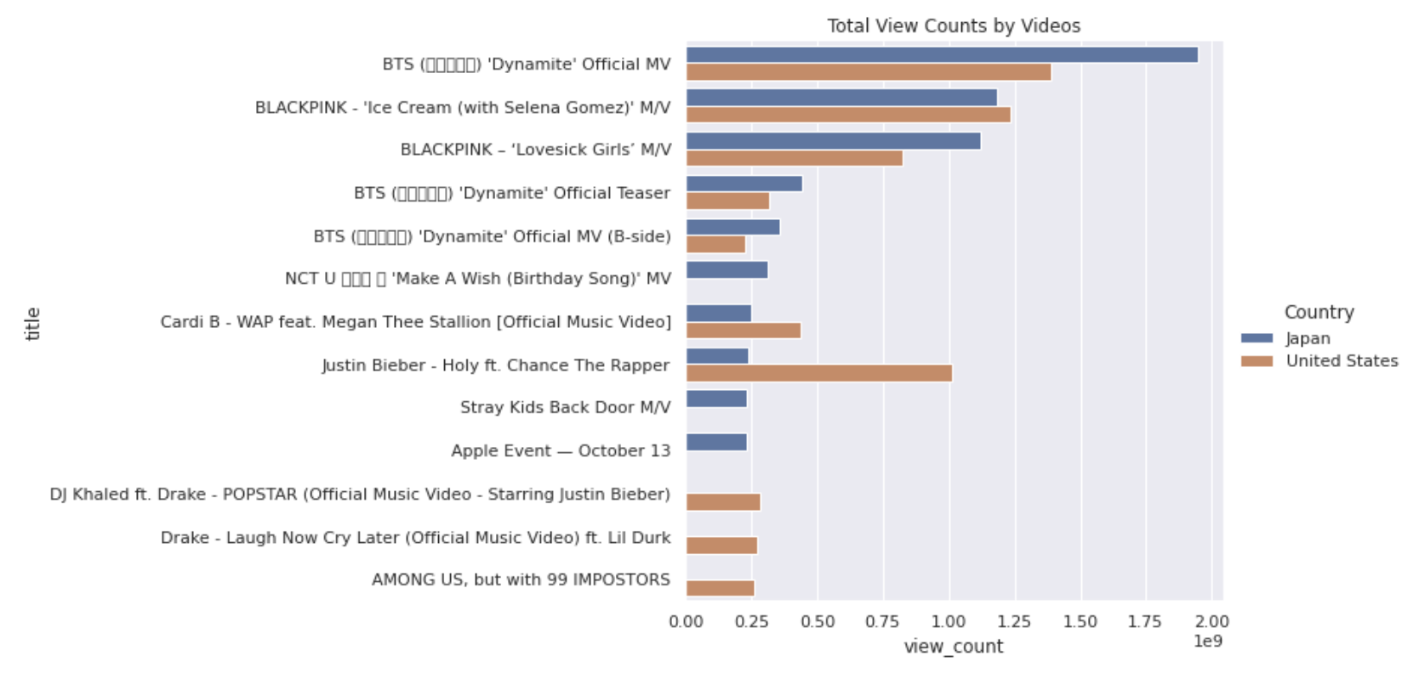

Top 10 videos for the US/Japan
views
Likes

Slide 14
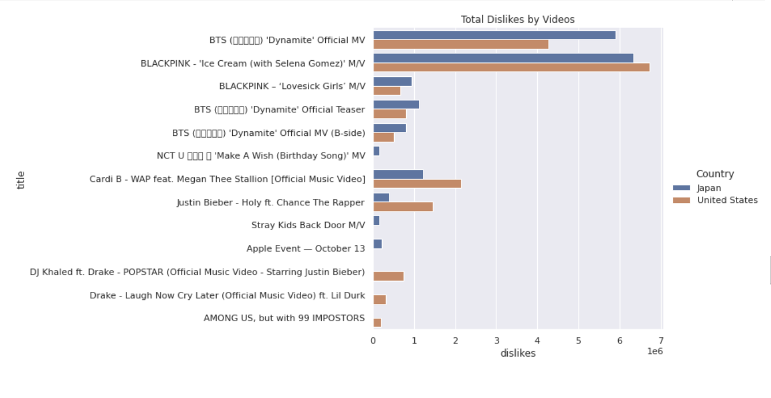
Top 10 videos for the US /Japan
Dislikes
The US
1.78M
Japan
1.73M

Slide 15
Findings
·Likes and view counts show a similar distribution for the top videos in the US and Japan
·Average dislikes for top US videos is more than for top Japanese videos

Slide 16
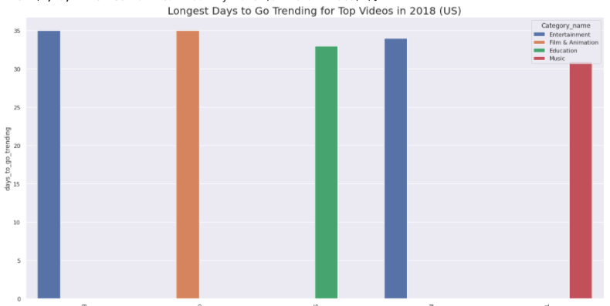
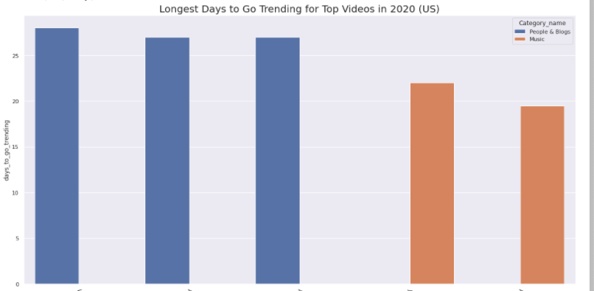
Top Trending videos in United States --The longest time for videos to go trending in the U.S

Slide 17
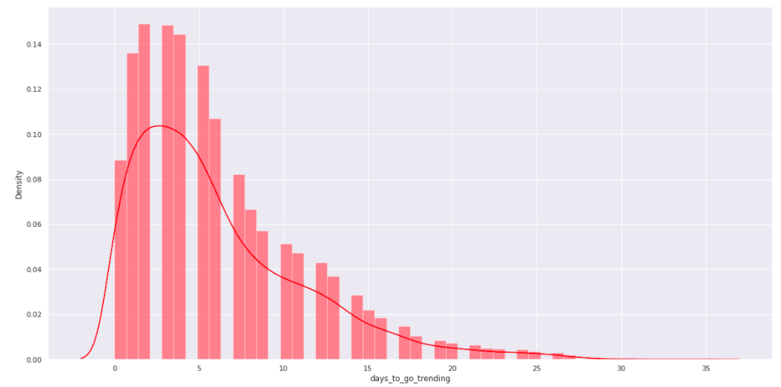
Distribution of days for videos to go trending in 2018 – the US

Slide 18
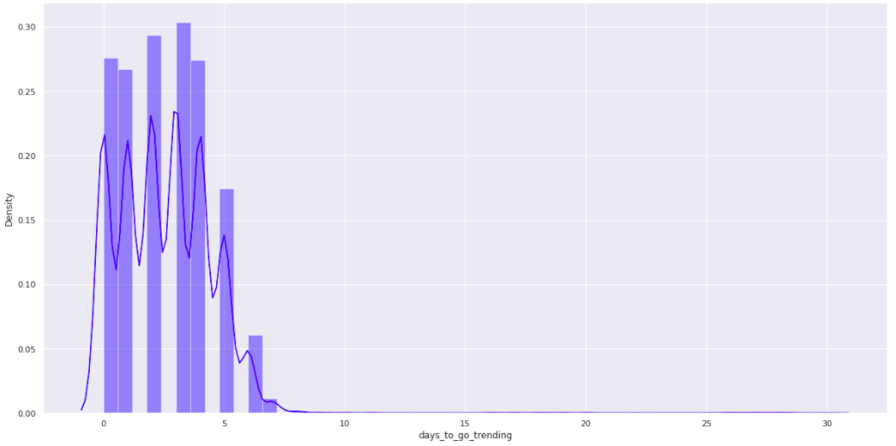
Distribution of days for videos to go trending in 2020 – the US
Days for large amount of videos spent 1-5 days to go trending

Slide 19
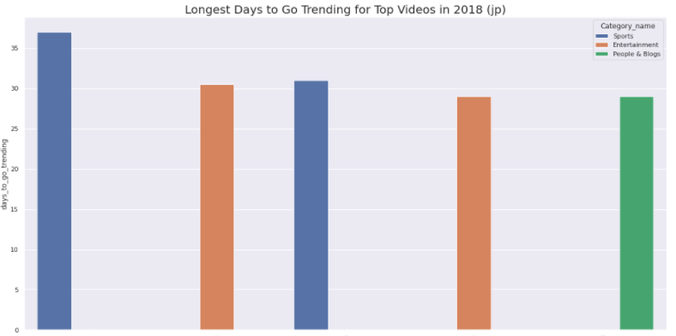
Top Trending videos in Japan --The longest time for videos to go trending in Japan

Slide 20
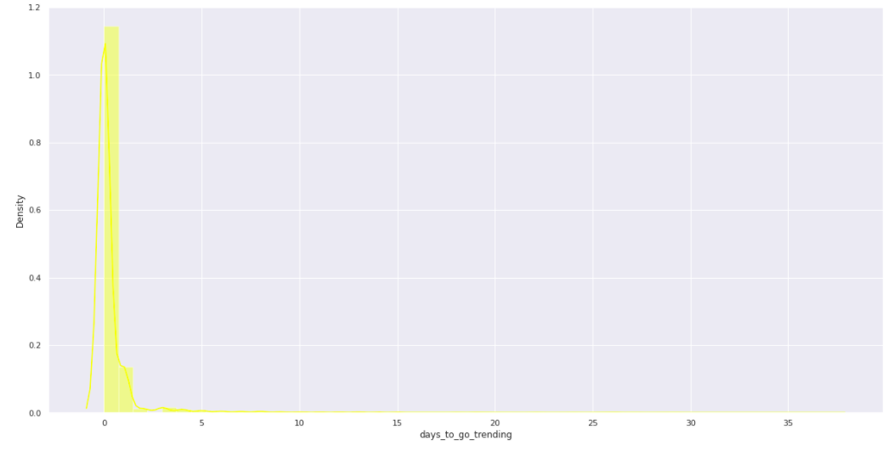
Distribution of days for videos to go trending in 2018 – Japan
Overall view of distribution

Slide 21
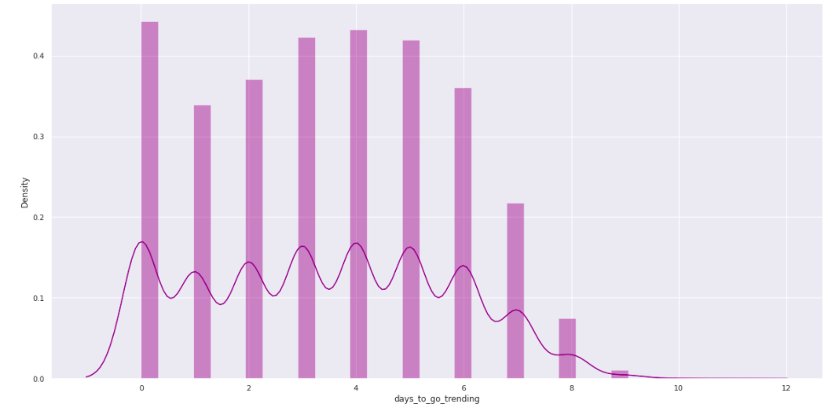
Distribution of days for videos to go trending in 2018 – Japan

Slide 22
Category Analysis
Prerequisite for Category Analysis:
Our Storyline
Dislikes
01
02
03
04
General View of User Interactions
U.S.A
Videos
Categories
Japan
Channels
What we do for categories
Select top 10 categories from 2 years and from 2 countries
Visualize average views, likes, dislikes, and comments per video
Discover characteristics among categories
Team 6

Slide 23
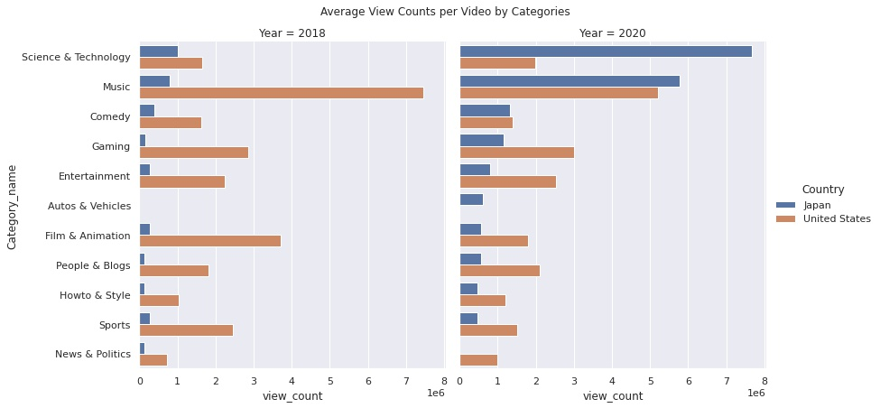
Category Analysis
views
Music as well as Science & Technology owns the most average view counts
In 2020, view counts shows reversed results in top 2 categories compare to 2018.

Slide 24
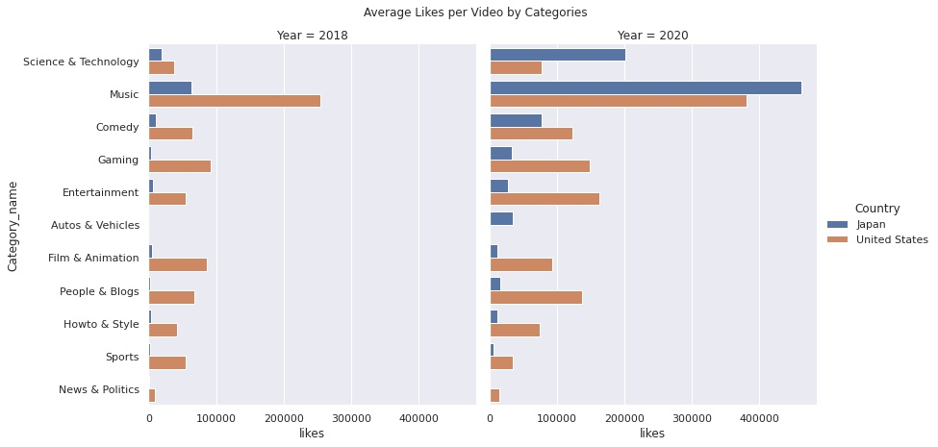
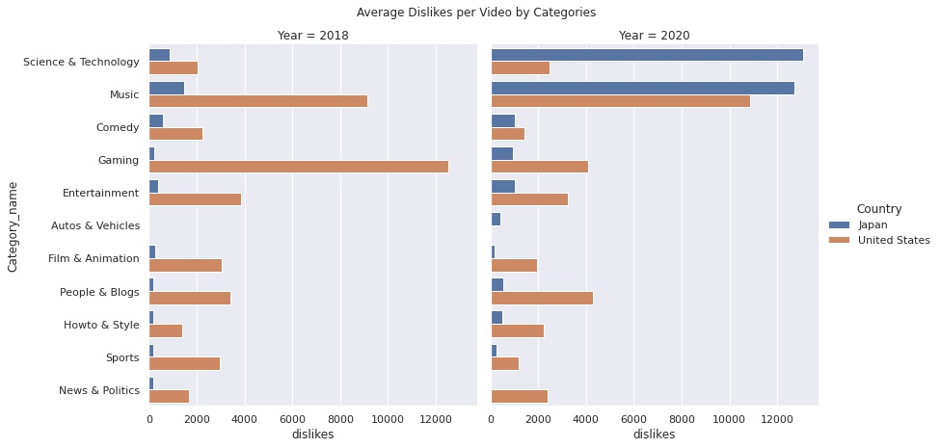
Category Analysis
Likes
Dislikes
Same in likes and dislikes!

Slide 25
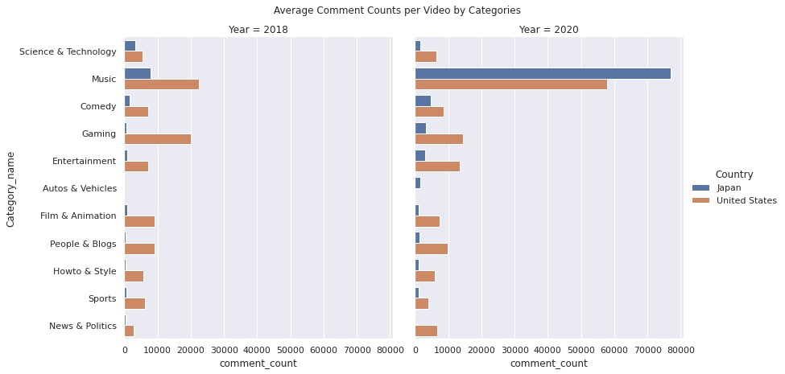
Category Analysis
Comments
Science & Technology, which all owns the most average view counts in Japan in 2020, perform differently in comments
Music performance on comments are similar to view counts

Slide 26

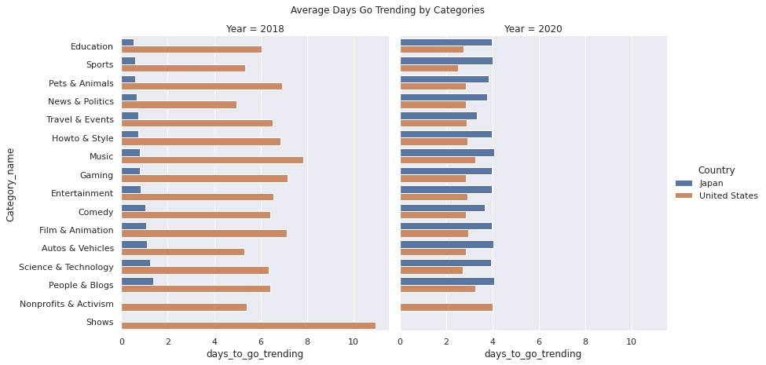
Category Analysis
Days
Days to Go Trending
U.S.A.
Japan

Slide 27
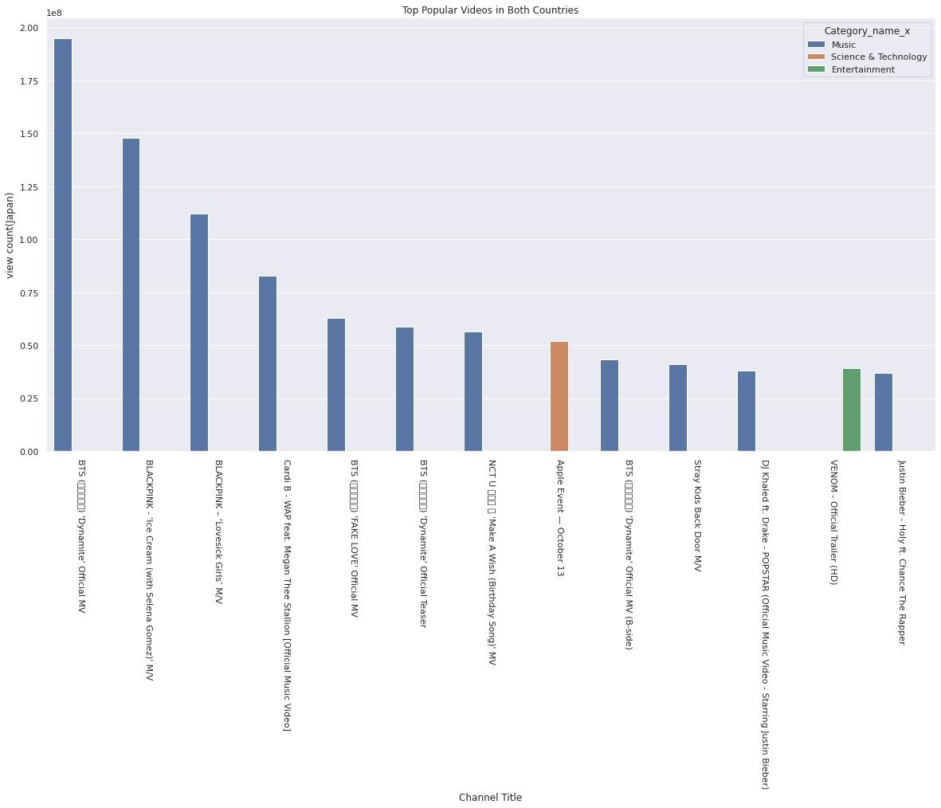
Relationship between Top Videos and Categories
11 of 13 top videos are from music category
8 of 11 music videos belong to Korean music
BTS and BLACKPINK are popular in both countries

Slide 28
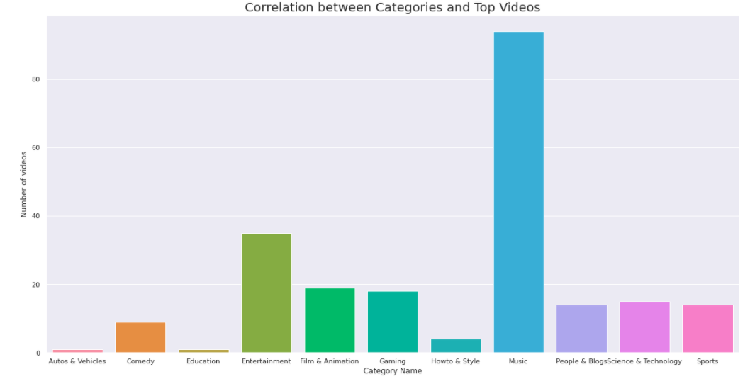
Relationship between Top Videos and Categories —Top 500 videos in the US & Japan
Music is the biggest part

Slide 29

YouTube Channel Analysis

Slide 30
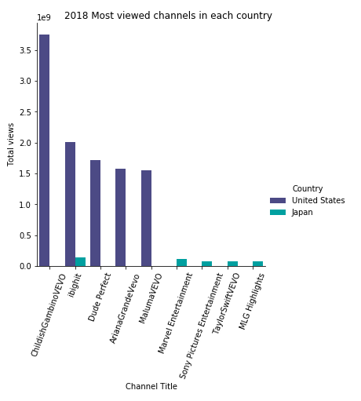
Top 5 Most Viewed Channels in 2018 for US and Japan
ChildishGambinoVEVO
TOP #1
US Channels
3.7B
Views
ibighit
TOP #1
Japan Channels
1.38M
Views
Match
Channel

Slide 31
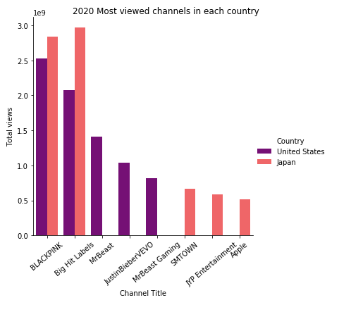
Top 5 Most Viewed Channels in 2020 for US and Japan
BLACKPINK
TOP #1
US Channel
2.5B
Views
TOP #2
Japan Channel
Big Hit Labels
TOP #1
Japan Channel
2.9B
Views
TOP #2
US Channel

Slide 32
YouTube Channel Statistics

Slide 33
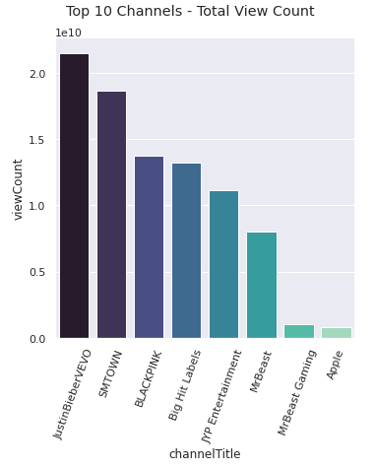
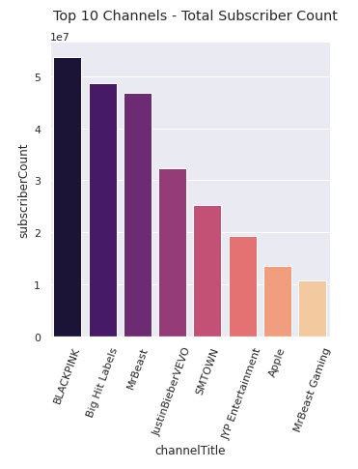
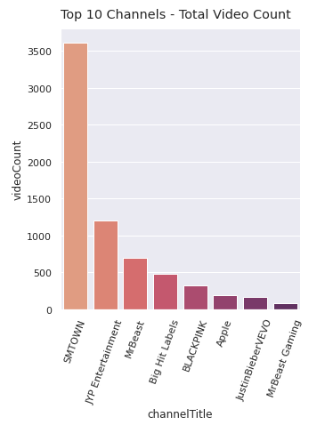
Statistics - Top 5 Most Viewed Channels in 2020 for US and Japan
JustinBieberVevo
21.6B views
32M Subscribers
163 videos
SMTOWN
18.6M views
25M Subscribers
3,608 videos
BLACKPINK
13.7M views
25M Subscribers
3,608 videos
Big Hit Labels
13.1M views
48.5M Subscribers
475 videos
JYP Entertainment
11.1M views
19.3M Subscribers
1,204 videos

Slide 34
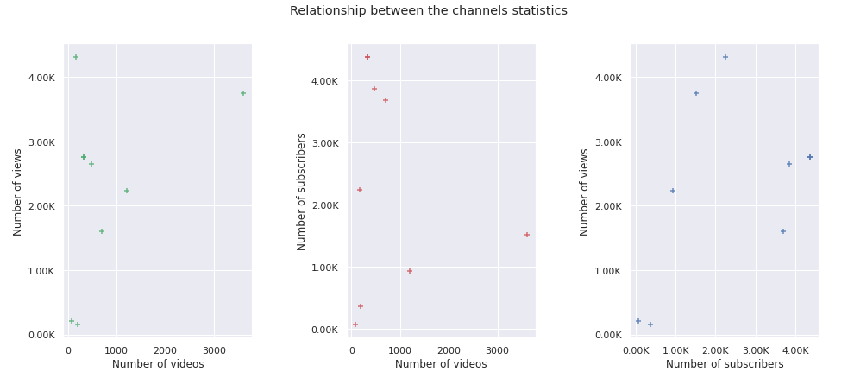



Top 5 Most Viewed Channels in 2020 for US and Japan
Unable to see any relationships
Could be: Between Subscribers and Views
More channels to
identify relationships

Slide 35
YouTube Channel Publish Time

Slide 36
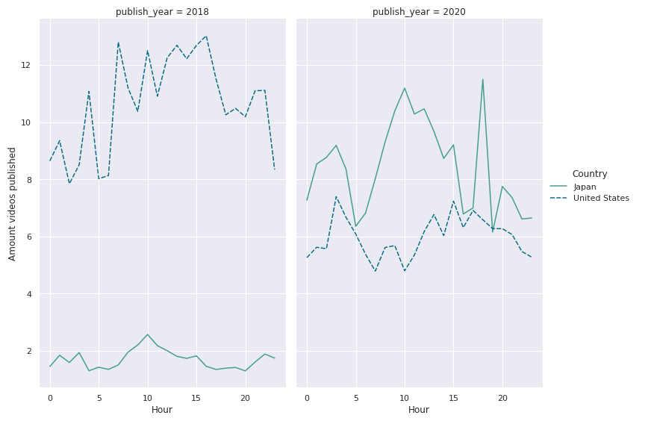

Channel Publish Hour Time Series for US and Japan
2018
2020
Japan ~10 am
~3-5 am
US ~ 3 pm
~6-7 pm
Year 2018- Preferred Publish hour around 10 am

Slide 37
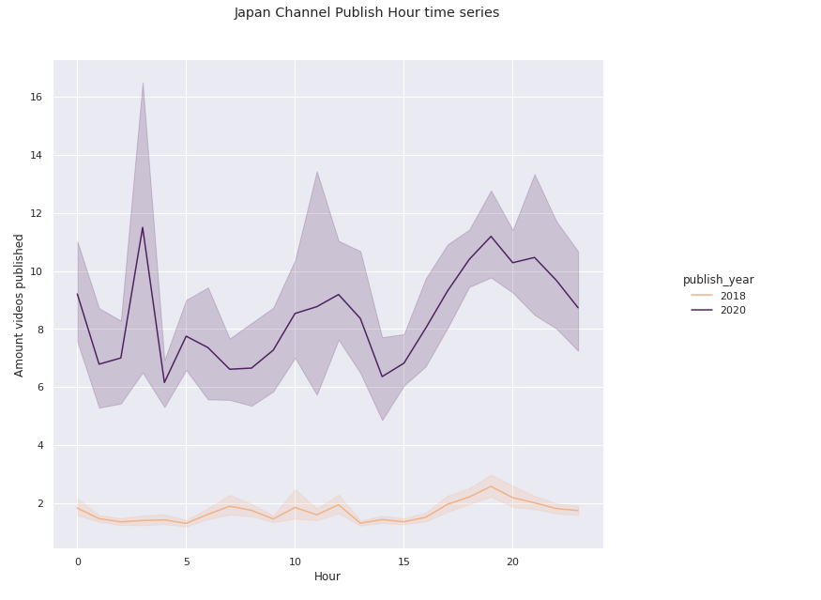


Channel Publish Hour Time Series for Japan
Asia time zone –
9 hours after UTC
14 hours ahead EST
More videos in 2020
Early morning and
afternoon

Slide 38
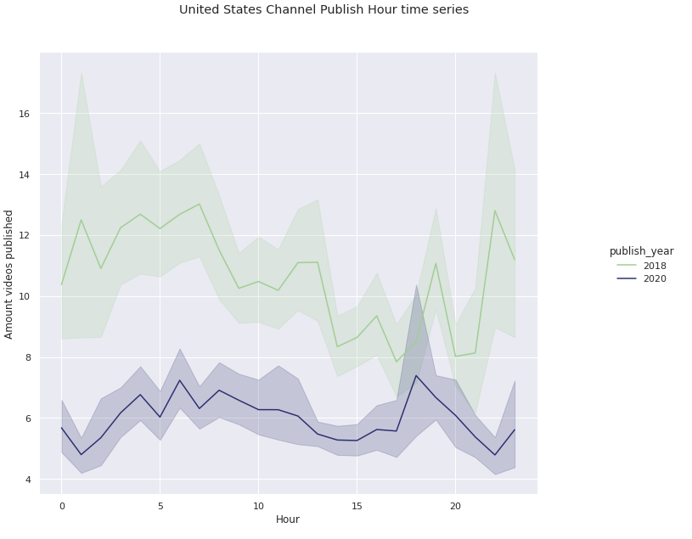
Channel Publish Hour Time Series for United States
LA time zone –
8 hours ahead than UTC
3 hours behind EST
More videos in 2018
2018- Early morning
and afternoon
2020-Early morning and
afternoon

Slide 39
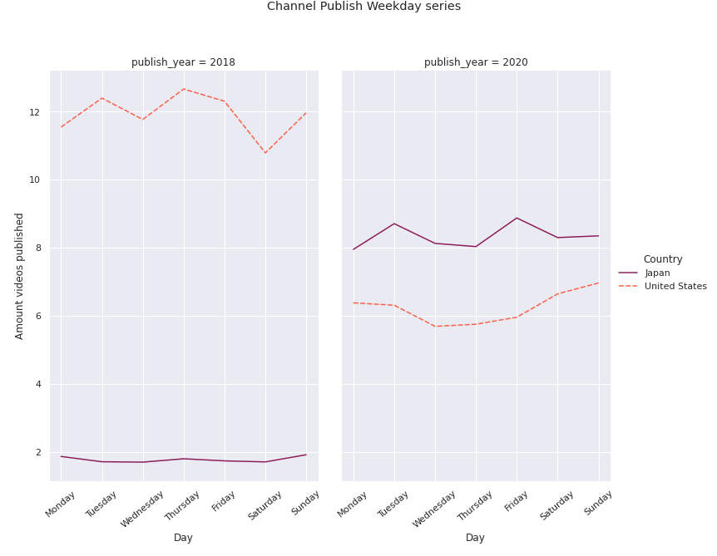

Channel Publish Day Series for US and Japan
2018
2020
US - Preferred to publish
in weekdays
Japan - No much difference
when compared to US
US – Continue to publish in weekdays but changed their preference for weekends
Japan - Preference publishing in weekends
(Since Thursday)

Slide 40
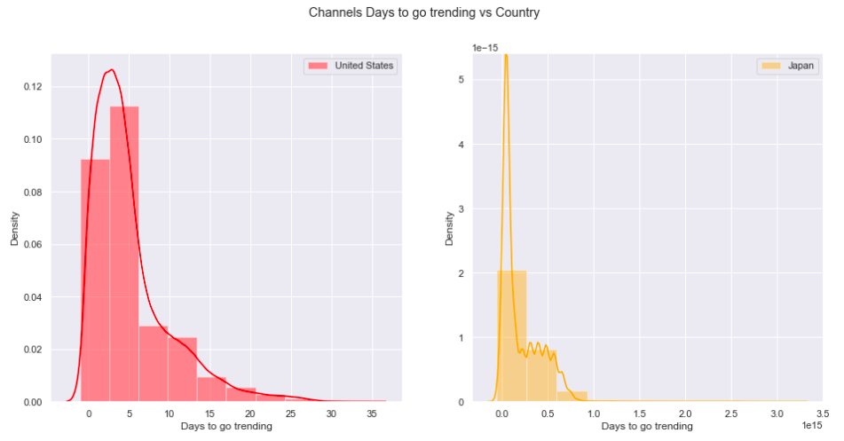
Channels Trending time for US and Japan
Japan channels
trend faster than US

Slide 41
Features for Videos
100K~1M
Views for trending videos on average
1
2~3
4
Comments per 100 viewing
Days for a published video go trending
Likes per 100 viewing

Slide 42




















Similarities and Difference
U.S.A
Japan
2020
Music
Similarities
Published and trending days in 2020, Time, Korean music, Gaming, Entertainment, Twitter, Facebook, and Instagram
Gaming
Differences
Published and trending days in 2018, Likes, Dislikes, Science and Tech, Manga, Yahoo, TikTok, Baseball, Tumblr, Football, and Movies
Entertain-
ment
Movies
Time
Sci 2020
Notes:
From the channel analysis:
Channel Publish Time - Both countries publish in early morning and late afternoon. By 2020, both countries started to publish more in weekends.
For 2018, US prefer to publish videos on weekday. The preferred published time for Japan is unknown in 2018. But in 2020, two countries all prefer to publish videos in the weekend.
Published hours are the same.
Trending days in 2020: 3-4 days
Trending days in 2018:
Japan

Slide 43
Team 6
Thank you!
Team 6A
Maraline Torres, Ying Zhang, Yujia Cao,
Yuting Gong, (Bruce)Chang-Hung Hou

Slide 44
YouTube
Trending Predictive Model

